Slide 1
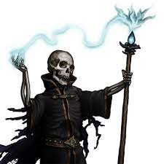
The Night of the Liche
Pitch Date: 12/18/2022 Update 1/15/2023
Release Date: 4/9/2023 82 Commits
Team Lead: Vince McKeown 9 Contributors

Slide 2
Vince McKeown
Enemy Class
Refactoring to create parent class
Started adding AI for walking
WIP Pathfinding
Started connecting NPC’s
Skeleton
Animated Skeleton Walk South
Alchemist

Slide 3
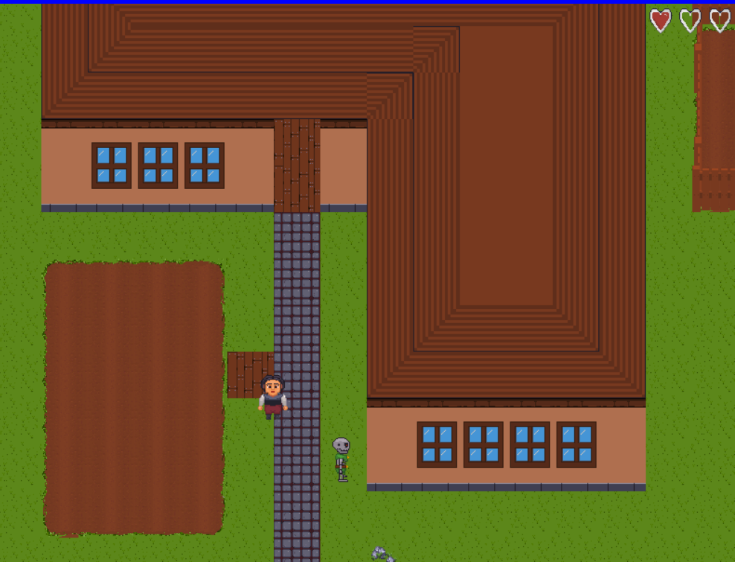
Chad Serrant
Hearts (Health)

Slide 4

Tylor Allison
Rocks

Slide 5
Paul Naser
Practice Commit

